Slide 1
Public Scholarship: A Case Study of a Dean’s Experience
Ron Marx, Dean
University of Arizona

Slide 2
Papers
Cabrera, N. L., Milem, J., F., & Marx, R. W., (2012). An Empirical Analysis of Mexican American Studies Participation on Student Achievement Within Tucson Unified School District. A report to the Federal Court Appointed Special Master for the Tucson Unified School District Desegregation Case. University of Arizona, College of Education.
Cabrera, N. L., Milem, J. F., Marx, R. W., & Jaquette, O. (2013). An Empirical Analysis of the Effects of Mexican American Studies Participation on Student Achievement within Tucson Unified School District. Paper presented at the annual meeting of the American Educational Association: San Francisco, CA. (Division G invited Vice Presidential Session)
Cabrera, N., Milem, J., Jaquette, O., & Marx, R.W. (2014). Missing the (student achievement) forest for all the (political) trees: Empiricism and the Mexican American Studies controversy in Tucson. American Educational Research Journal, 51(6), 1084-1118.

Slide 3
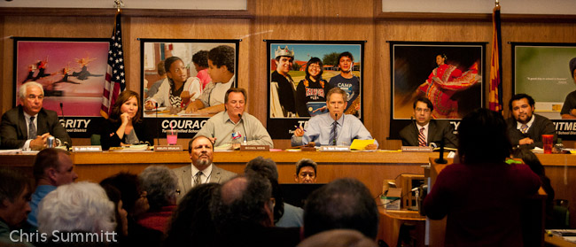
January, 2012
TUSD Board Eliminates MAS; Vote 4-1

Slide 4
TUSD Relationships
Relationships with Superintendent
Former faculty member
Network of relationships with other
Largest district in region
Parternships
Teacher education
Environmental learning
Research projects

Slide 5
Board Member Stegeman
Periodic constituent letters
Memo to court
“It should receive no weight in the court’s deliberations”
“Two of the three authors…cannot reasonably be considered impartial”
“Numerous weaknesses
statistical model unclear
insufficient to allow replication of the results
appears to be a basic error in the specification of the logit model
assumptions behind the significance tests are unclear
No attempt to control for selection effects”

Slide 6
Doug Maceachern, AZ Republic
“Insideious Latino Studies Being Revived in Tucson Schools” (12/15/12)
Does anyone really believe these guys were going to produce a study that concluded classes laced with Paulo Friere's Marxist oppression theories would not cure all education ills? Really? That's the other infuriating aspect of the MAS debate: It is a game being played out by university-level radicals.
“Bit of Leftist Engineering in Tucson is Expensive” (02/11/ 13)
“They are of a tight circle of race-centric education theorists. They cite each other. They feed off each other. And, as we see now at TUSD, they prop up each other’s missions.”

Slide 7
Donors
Follow these issues closely
Read news
Clip articles and conduct on-line searches
Expect (and get) face time through donations and volunteer work
Private meetings with me to raise their concerns
Want dean to support K-12 education
Prefer I not take stands on controversial issues…unless they agree with my stance.

