Slide 2
Notes:
Education changes are coming fast & furious!

Slide 3
Main Points
COEs need not be passive or subordinate
COEs can lead major initiatives and impact societal issues in 7 steps
Notes:
Well, here goes... Supposed to lead with main points. Here they are!
In addition to main points, I’ll also describe the 7 steps, so you know what you might encounter along the way.
I’ll also offer a few tips while sharing a story that illustrates the journey to help you be successful should you opt to do something similar.
Now, you can return to your tweeting!

Slide 4
Notes:
Step 1-- What is the public issue/challenge/goal you seek to address?
Step 2 -- What options/resources does the dean or college have available to address an important issue?

Slide 5
Notes:
In our case, we chose optimizing early childhood development

Slide 6
Optimizing Early Childhood Learning & Development
90% of brain development occurs in first 5 years of life
1 in 3 children enter kindergarten unprepared for school
Shapes trajectory for growth
Notes:
We thought it was important and we had expertise in college

Slide 7
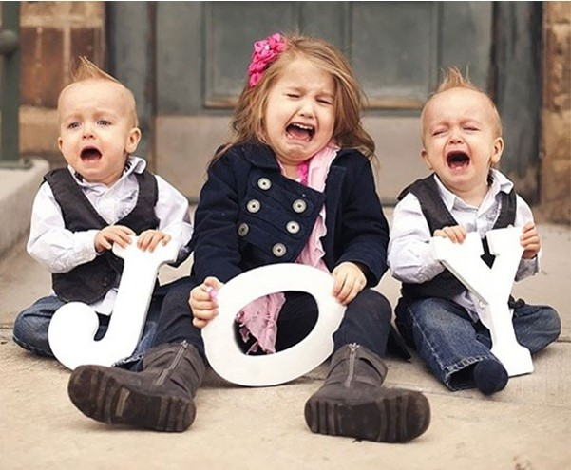
Notes:
Statewide survey indicated 700K kids attending some form of early learning program spread across a disjointed network of 30 early learning coalitions across the state
Quality varied from very high quality learning experiences with professional staffs
-- to some of lowest quality care being provided to children who needed it most – such as being buckled into car seats on the floors in front of a TV for hours at a time.
As reflected in this image of 3 children supposedly depicting “JOY”, these were not growth promoting conditions or happy kids

Slide 8
What Can We Do About It?
Environmental scan of:
Nation
State
University
College
Community
Notes:
Step 3-- What are broader political contexts and constraints of which the dean and/or public scholar should be cognizant?
EC federal priority
Decentralized university with 16 colleges – boats on their own bottoms
Collaboration based on good will among deans, not on institutional structure or incentives.

Slide 9
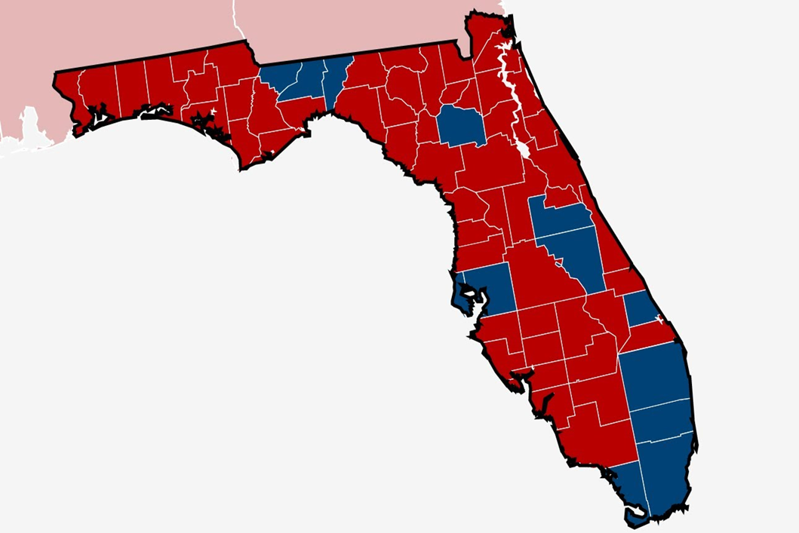
Florida
Notes:
Florida:
No state income tax
Tolerance of economic / resource disparities
Decentralized, community-based services
Politically polarized, reflecting diversity of country

Slide 10
Seizing Opportunity & Making the Case
Optimizing Early Childhood
President
Provost
VP for Advancement
VP for Research
Univ Communications
Notes:
Step 4 – Determine what communication medium(s) are most appropriate to effect the desired outcome?
Step 5 -- How should support be garnered for the plan and from whom? …DON’T SURPRISE YOUR BOSS!
We chose National Summit – invite key national and state stakeholders

Slide 11
Enacting the Vision
Notes:
Herding CATS! With many accustomed to being Top Cat among equals!
Make the case for intensive collaboration among constituent groups
Our university participants included 7 colleges, 8 departments, and 3 centers

Slide 12
Expect to Encounter…
Design & Implementation Challenges
Notes:
Sign on gate say: “Notice: Keep gate closed and locked” But there is no fence on either side of the locked gate!
Challenge to coordinate cohesive vision and priorities among many stakeholders

Slide 13
Expect to Encounter…
Challenging Communications & Behavior
Notes:
As momentum, excitement, & publicity grow:
Those who have not been involved or even interested -- suddenly want to be involved or have large say in decisions.
Those that were initially involved on small scale, suddenly want to be leaders.
As a colleague says, we study kids with challenging behaviors, and display them ourselves!

Slide 14
Enact the Plan - Persist!!
Notes:
Step 6 -- Enact public scholarship plan
You may have heard that Gwen Jorgensen told her coach that was going to retire from triathlon after a bad race?
Coach said to take the weekend and think about it.
She went on to win gold in Rio -- with the fastest run time of the day!
There may be many times when team wonders what we’d gotten ourselves into?
We considered surrendering to on-going influences that would have distracted,
or even detracted from the primary messages.
We opted to stay the course, and are glad we did.

Slide 15
Assess Outcomes…
National
Summit
Notes:
Contentious challenges included deciding who to invitee and how to allocate time slots

Slide 16
Outcomes…
Early Learning Florida PD System
Notes:
Almost 3,000 early learning teachers achieved mastery of the courses
Practitioners were located in 800 early learning provider locations
Serving more than 15,000 children
On track to at double those numbers this year.

Slide 17
Outcomes…
More statewide attention
Improved services
Mobilized local involvement
Increased research & grants
Creating demonstration sites
Activated donors
Notes:
Lots of positive outcomes so far…
Step 7 -- Assess outcome. If not successful, repeat steps 1-6 with new info obtained by the first time through!

Slide 18
Take Away
Deans can lead public scholarship initiatives enhancing knowledge
& improving society!

Slide 19
Questions/Comments?

