Slide 1
Independent Teacher Education Programs:
Aprocryphal Claims, Illusory Evidence
Ken Zeichner
University of Washington

Slide 2
The Importance of Evidence
"We have made major progress during this Administration in directing investments in education to evidence-based strategies …Relevant, rigorous evidence must be an essential part of a strong framework for decision-making.”
Secretary of Education, John King
September 2016

Slide 3
Apocryphal Claims
Relay receives continually receives praise from the Department of Education for offering programs that “require teachers to demonstrate evidence of effectiveness in classrooms before completion.”

Slide 4
Purpose
To examine the claims of success made about a sample of independent programs (by the programs and by others) to determine the extent to which they are supported by credible evidence
Examine their impact on teacher quality, student learning and on other outcomes.
Independent programs are a subset of Non IHE-based programs that do all of the preparation themselves.

Slide 5
Equity Concerns
It is important to scrutinize independent programs in a way they have not been examined before because they prepare teachers primarily and in some cases exclusively for schools in low- income communities.

Slide 6
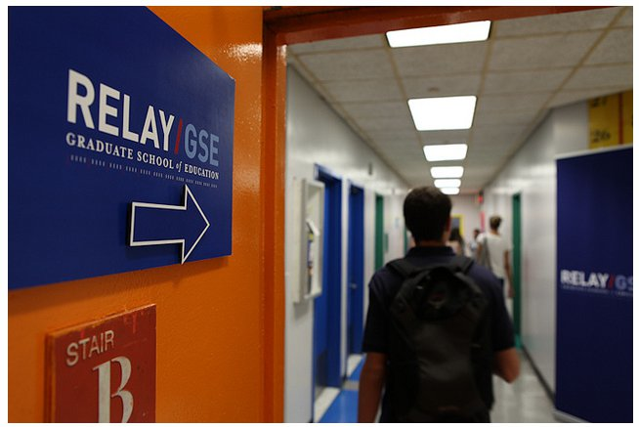

Slide 11
Methodology
Examined the material on the websites of the five programs and interviewed someone from 3 of the programs-HTH, iTeach, and TEACH-NOW.
Relay and Match did not respond to repeated attempts for an interview between February and July 2016.
Relay and Match finally responded when I asked them to verify the research and evaluation studies that I used in my analysis and asked them for any additional studies or evaluations.

Slide 12
Examined
Four peer-reviewed syntheses of the research on alternative pathways to teaching.
OERI 2001
AERA 2005
NRC 2010
AERA/HRT 2016

Slide 13
Examined
Research and evaluations conducted by the programs themselves and discussed on their websites or in papers and reports posted on their websites.

Slide 14
Research Syntheses
Cochran-Smith & Villegas 2016
Studies are inconsistent and ultimately inconclusive at a broad level in terms of what they tell us about the effects of particular programs.
NRC 2010
The lack of clear findings does not mean that the characteristics of pathways do not matter…

Slide 15
Found- Program “Studies” and Other Evidence
One peer-reviewed study of teacher-parent communication strategies taught in MTR that had a positive impact on students.
Testimonials from graduates and employers.
Success in raising student achievement in charters associated with programs.

Slide 16
Found Program “Studies”
Match and Relay presented vague data on teachers accomplishing their student achievement goals (Relay), and outperforming graduates from other programs (MTR).
Some raw retention data (e.g., TEACH-NOW) with no information about teachers or contexts.

Slide 17
Conclusions
There is no credible evidence (independent and vetted research or evaluations) that supports the claims made about these programs by themselves and by others.
Based on the data that I was able to access, two of the programs, Relay and Match appear to contribute to the inequitable distribution of professionally prepared teachers and to the stratification of schools by social class and race.

Slide 18
Policy Recommendations
Do not provide funding streams and policies that privilege independent programs until justified by evidence.
Be careful states about authorizing teacher preparation academies.
Analyze both the costs and benfits fo different approaches and not just whether teachers can raise student achievement.
Monitoring provisions in state and federal polices to prevent further stratification.

Slide 19
Independent Programs, The HEA Regulations, and ESSA Title 2
The Next Frontier for Entrepreneurs.
Putting Programs Out of Business (Merrow).

Slide 20
INDUSTRY OF MEDIOCRITY
Notes:
TEACHER EDUCATION HAS FAILED –WE NEED TO BLOW IT UP AND REPLACE IT WITH SOMETHING ELSE. WE ALSO NEED TO GET RID OF BAD TEACHERS, BAD SCHOOLS AND REPLACE THEM WITH SOMETHING ELSE.

Slide 21
ACCUSATIONS OF FAILURE
IT IS A KNOWN FACT THAT TEACHER EDUCATION HAS FAILED (KATE WALSH, NATIONAL COUNCIL ON TEACHER QUALITY)

Slide 22
THOMAS ARNETT (CLAYTON CHRISTIANSON INSTITUTE FOR DISRUPTIVE INNOVATION).
DESPITE A FAIR AMOUNT OF CONSENSUS REGARDING NEEDED REFORMS, SCHOOLS OF EDUCATION SEEM TO HAVE DONE LITTLE OVER THE LAST 30 YEARS TO FUNDAMENTALLY CHANGE THEIR BUSINESS MODELS TO ALIGN WITH SUGGESTED REFORMS.

Slide 23
Norman Atkins, Relay's co-founder and president, says Drake and other leaders of traditional institutions are probably "anxious" about needed changes that are taking place in "a field that has not made a lot of progress in a very long time."

Slide 24
“Teacher preparation 2.0”
Billie Gastic, former Research Director, Relay GSE

Slide 25
“Startup teacher education”
Thomas Arnett, Clayton Christianson Institute for Disruptive Innovation

Slide 26
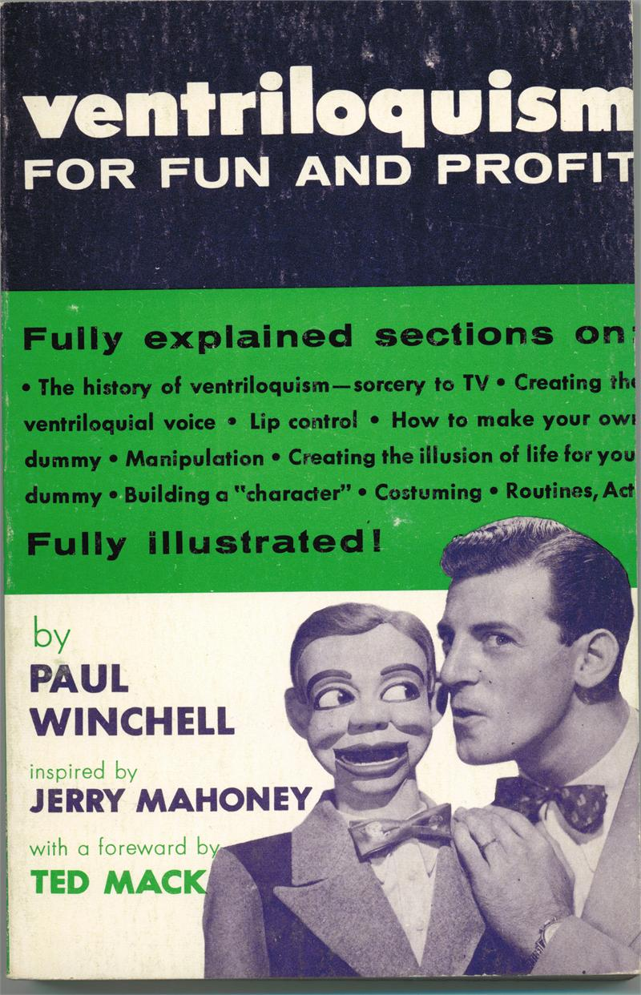
Notes:
RESEARCH IS MISUSED TO SUPPORT A DEREGULATION AGENDA.

Slide 28
Knowledge Ventriloquism and Echo Chambers at Work
The Levine Report
Relay Graduate School of Education
NCTQ
2012 House and Workforce Committee Hearing on Alternative Certification

Slide 29
Arne Duncan, October 2016
The system we have for training teachers lacks rigor, is out of step with the times, and is given to extreme grade inflation that leaves teachers unprepared and their future students at risk.

Slide 31
Help Teachers Before They Get to Class
New York Times Editorial
October 14, 2016

Slide 32
Supporters of the HEA ‘Rules”
Ed Reform Now
Deans for Impact
Democrats for Education Reform
National Council on Teacher Quality
TFA
TNTP
Chiefs for Change
Relay GSE
Success Academy Charter Schools

Slide 33
Presenting the Regulations in LA
Not there- AACTE, CAEP, CSSO, NASDTEC, NEA, AFT.
Was there- Undersecretary Ted Mitchell, Ben Riley Exec Director Deans for Impact+ USC faculty and friends.

Slide 34
How Should Ed Schools Respond?
Ignore it all.
Defend the status quo and brag about all of the good things we are doing in ed schools.
Accuse the “invaders” of being greedy neoliberals out to wreck public education.
Recognize the reality, and push all programs to meet high standards for a professional education for teachers.

Slide 35
Go it alone
Form alliances with districts, teacher unions, local community leaders and advocate for strong public education and a well supported teaching profession.

Slide 36
Current Debates in Teacher Education
Defenders (1.0)
Reformers (2.0)
Transformers (3.0)

Slide 37
A NEW ARCHITECTURE FOR TEACHER EDUCATION
School
Practitioner Knowledge
Teacher Education
University
Academic Knowledge
Community
Community-Based Knowledge
Notes:
If we are preparing teachers to teach in a democratic society, then our programs of preparation must embody an epistemology that is in itself democratic. There must be respect for AND interaction among academic, practitioner, and community-based knowledge. What we are arguing for is different from the current wave of interest in teacher residency programs that place practice at the center of preparation and wrap coursework around this practice. We are concerned with the creation of new hybrid spaces where academic, practitioner and community-based knowledge come together to develop new hybrid solutions to the complicated process of preparing teachers. The creation of new hybrid spaces must be less hierarchical and less haphazard in how we support teacher learning.
To further theorize collaborations among academic, school, and community-based sources of knowledge, we use conceptual tools afforded by Cultural Historical Activity Theory, or CHAT.
Two of the key ideas in cultural-historical theories are that expertise is distributed across systems AND that individuals develop ways of thinking and acting that are afforded by the cultural practices and tools make available to them in the settings of their development. Specifically we draw on the concepts of boundary-crossing, horizontal expertise, and knotworking. These conceptual tools are rooted in Engestrom & colleague’s examination of work that occurs across organizations such as healthcare providers.
Boundary-crossing occurs when organizations must cross their institutional and even ideological boundaries to work with others so that they can create new solutions to a common problem. It asks each organization to articulate new goals, practices and tools to solve a common problem.
Horizontal expertise can be a result of boundary crossing in these professional collaborative efforts. As opposed to hierarchical, or vertical notions of expertise, horizontal expertise recognizes the unique knowledge and understanding that each profession brings to the collective activity. Each professional develops a range of expertise across work and organizational spaces, but working collaboratively these forms of expertise serve as resources in joint-problem solving. These collaborations can further organize the traditional hierarchies of expertise and further innovative solutions to the dilemmas of each group’s everyday work life.
Finally, knotworking offers a way to understand the learning of teacher candidates that occurs when there is collaboration across activity systems – university, school, and community. Engestrom conceives of the different interests, values, and practices of these different systems as mediated in knots, which he refers to “a rapidly pulsating, distributed, and partially improved orchestration of collaborative performance between otherwise loosely connected actors and activity systems (1999).
Today we will be considering possibilities in teacher education to further the creation of these hybrid spaces. We will first look at accessing community-based knowledge, then move on to work around accessing school knowledge through practice based teaching methods, and finally discuss further implications for this work.

