Slide 1




Fund Raising: Lessons Learned
Gregg A. Garn
University of Oklahoma
Renée A. Middleton
Ohio University

Slide 2

Preparing yourself: Fundraising rarely comes naturally
You’re asking before you’re offered.
You’re talking about money.
You’re exploring personal matters.
You don’t always take no for an answer.
You’re coming face to face with your fears
  Fear of failure
  Fear of rejection
  Fear of the unknown
Notes:
Marcy

Slide 3
But, Fundraising is a noble endeavor; it is Friendraising
More than simply asking for money
Cooperative relationship rather than adversarial act
Fulfilling mutual needs rather than doing a deal
Life enhancing, not life diminishing
Positioned within your institution and unit’s history
Essential for the life of your SCDE
Notes:
Renée

Slide 4
Who Gives?
Sources of gifts to all Charities:
  Individuals – 73%
  Foundations – 14%
  Bequests – 8%
  Corporations – 5%
Sources of Gifts to Higher Education:
  Alumni – 25.4%
  Foundations – 30.0%
  Non-alumni – 17.6%
  Corporations – 16.9%
  Other organizations – 9.1%
  Religious organizations – 1.1%
Notes:
Marcy

Slide 5
Why people give
Moved at how gift can make a difference – 72.4%
Feel financially secure – 71.2%
Giving to an organization that is efficient – 71.0%
Support same orgs/causes annually – 65.9%
Political/philosophical beliefs – 52.1%
Volunteer for the organization – 51.9%
Give spontaneously to support a need – 47.1%
Remedy issues affecting me personally – 43.8%
Religious beliefs – 38.8%
Being asked – 27.1%
Notes:
Marcy

Slide 6
The Return of the Mega-Gift
Total Number of $1 Million-Plus Gifts, 2006 – 2012
Higher Education receives more than half of all gifts at this level.
The drop in giving experienced in 2009 – 2010 was driven by top-of-the pyramid donors.
Million dollar gifts fell more than 50% between 2007 and 2010
2007 – (n= 506)
2008 – 2010 (n= 379, 284, 231)
2011 – 2012 (n= 375, 404)
2011 and 2012 signaled a promising reversal, as million dollar gifts grew by 62%; this is still only 75% of the 2007 high mark. The trajectory is a positive sign of things to come in 2013 and beyond.
Source: The Chronicle of Philanthropy, America’s Top Donors
Notes:
Renée

Slide 7
Do You Have The Right Ingredients for Fundraising Success?
Do you have a big, fundable idea?
  At high performing higher education fundraising organizations deans perform some version of the following critical roles:
    Bringing passion, vision, and priorities for the institution and academics with a clear and consistent case for support;
    Connecting and inspiring faculty to engage in development work;
    Playing a key role in developing big, fundable ideas and campaign planning; and
    Being key partners in identifying prospects, goal-setting, and program planning.
    Source: Eduventures, Inc.|www.eduventures. com
Notes:
Renée

Slide 8
Major Gift Fundraising
Have a transformational vision
View major gifts as investments
  Funds follow good thinking and planning
  Must be friend first - trust is key
  All donors are unique
  Donors not necessarily alumni
  Women playing increasingly important role
  Don’t underestimate power of your position
Notes:
Marcy

Slide 9
Know Where You are Going
Have a Strategic Plan for your SCDE
  Clarify the vision for the future to your constituents
  Set benchmarks – actions & target completion dates
  Reallocate resources and focus
  Attend to institutional structure
Develop a corresponding Fundraising plan
  Tied to strategic plan
  Bold but doable
Notes:
Renee and Marcy

Slide 10
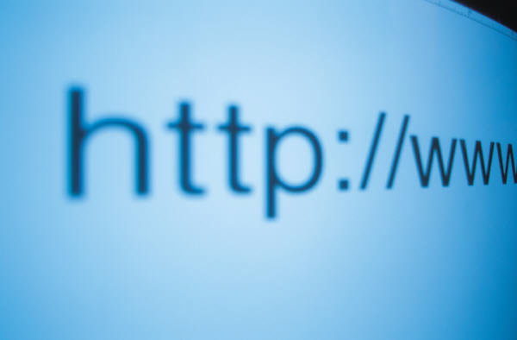


Sell where you are going
How do you communicate your vision
  Enhance your public image - PR plan for SCDE
  Strategic use of faculty, friends and events
  Donor and prospect visits
  2 minute drill
Notes:
Renee and Marcy

Slide 11

It takes a village (inside)
Development officer(s) responsibilities
  Prospect identification and qualification
  Donor relations
  Managing boards
  Managing your time and planning your travel strategically
  Major gifts vs. annual giving and smaller gifts
Central Foundation support
  Research
  Gift processing
Support from faculty and students
Support from above: President, Provost, Foundation President
Notes:
Marcy and Renee

Slide 12
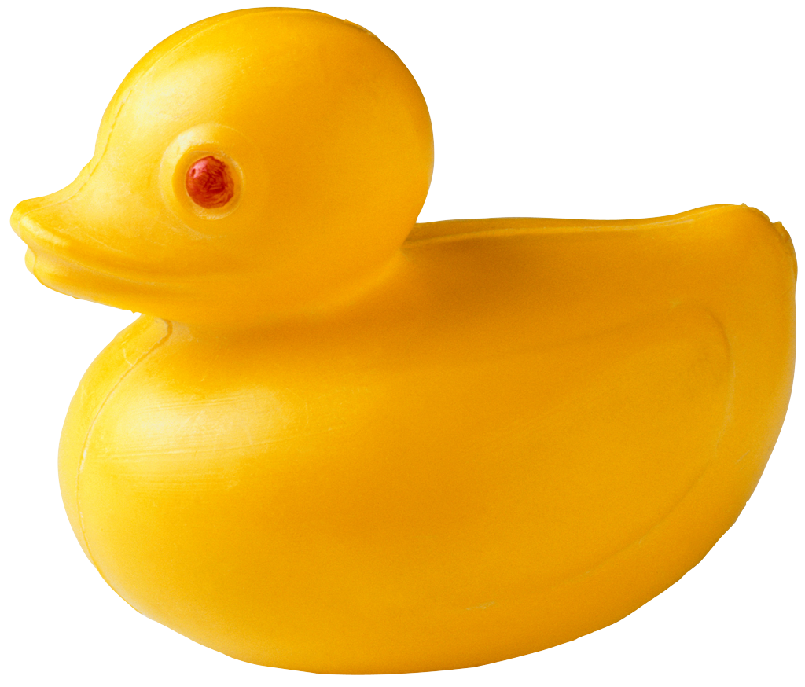
It takes trust
Donor relations
  First gift not the last-
    Personal touch
    PR demonstrating impact of funding
    Receiver communication
    Managing internal competition
    Tchotchke
Notes:
Renee and Marcy

Slide 13
Vision and Priorities
Scholarships
  Undergrad versus graduate
Faculty Support
  Chair, Professorships, Presidential Prof
Programs and Ideas
  Study abroad and STEM/STEAM
  Reach out to corporations, foundations and individuals outside College
Spaces
  Buildings, rooms, courtyards, benches,
Estate Gifts
Notes:
Marcy

Slide 14
Board of Advocates/Advisors
Clear Purpose?
  Networks,
  Insight,
  Financial support
Committee work
Life time appointment?
How representative is your BoA?
Other advisory groups
  Retired faculty, other deans (internal/peers), young alumni
Notes:
Marcy

Slide 15
Ideas and Investments
With decline in state support increasingly important
Investments (not gifts)
Ideas and relationships
Notes:
Marcy

Slide 16
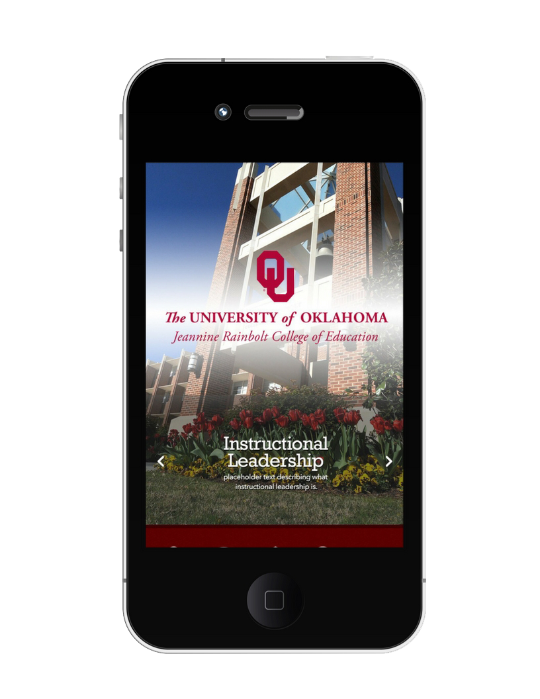
Development Communication
  We are really good at saying thank you
    Handwritten
    Also separate note on impact of the gift
    Don’t thank and ask for more in the same communication.
  JRCoE App
    Alumni
    Parents
    Donors
Notes:
Apps are the number 1 source for information for college age students. Texting is the number 1 form of communication- a 95% read rate vs email at 10% for college age students. Over the summer we began working with a group on the research campus to develop a JRCoE app. Since we provide ipads for UG students its an ideal way to connect.

Slide 17
Micro-Campaigns
Crowdfunding
  Need an engaged following (active not lurkers)
  Cultivating first time donors
  $10,000 or less project based
  Lead donor 1:1 match
  Find your Future and Certification fees
Notes:
Marcy

Slide 18
Events
What is the purpose of your event?
  Tough on staff
    Smaller is better (facetime with dignitary)
    Connecting into University event
      Athletics, fine arts, scholarly speakers
  Events are good for:
    Celebration, Developing relationships, Stewardship
  Events are bad for:
    Raising funds (DVO time investment for gifts always wins)

Slide 19
Gifts You Should Not Accept
Donors come up with ideas that don’t align to your mission and goals
Accepting that money often results in an administrative nightmare
Likely to burn a bridge with the donor
Donor centric- if isn’t the right fit, hand them off to another college. It is hard to do, but they will come back to you.
Keep their vision at the forefront.
Notes:
Marcy

Slide 20
What Are Your Final Thoughts?
Q & A

