Slide 1
Education Reimagined: The Top 10 Education Innovations of the Last 100 Years and a Forecast for the Future
CADREI Fall Conference
October 18, 2016
John E. Jacobson
Ball State University

Slide 2
Defining Innovation…
Something new
Concept/Idea/Philosophy
Policy
Instructional Practice
Method/Curriculum
Custom
Classroom/School Design
Device
Latin (innovatio) to English translation = renewal

Slide 3
Designing the Study…
Selecting innovations to include in survey:
Asked Ball State education faculty
Searched the Internet
Narrowed the list to 55 innovations
Survey Design—consulted with Educational Psychology faculty
Used Qualtrics
Emailed survey to 878 deans/unit heads from 9/10/2015 to 9/18/2015

Slide 4
Dear Colleague,
I am preparing a presentation to be given later this fall to a group of educators titled, “Education Redefined: The Top 10 Educational Innovations of the past 100 years.” I researched and narrowed the list of educational innovations to just over 50, and now call upon you for your assistance. Would you please take 5 minutes to review the list and provide your opinion on the degree to which each innovation has had or will have on P-12 education—either positive or negative. I think you will enjoy reviewing the many educational innovations of the last 100 years—maybe even do a little reminiscing as you consider each.
This is the only email you will receive. I would appreciate you completing the survey by Friday, September 18.
There is a place at the end of the survey to put your name and email address if you would like to receive a summary of how your colleagues rate each innovation. I am inviting educator preparation program leaders from across the nation to respond. All responses are confidential, and only aggregated data will be reported.
Thank you in advance for taking the time to review and share your opinions.
Best wishes,
John

Slide 5
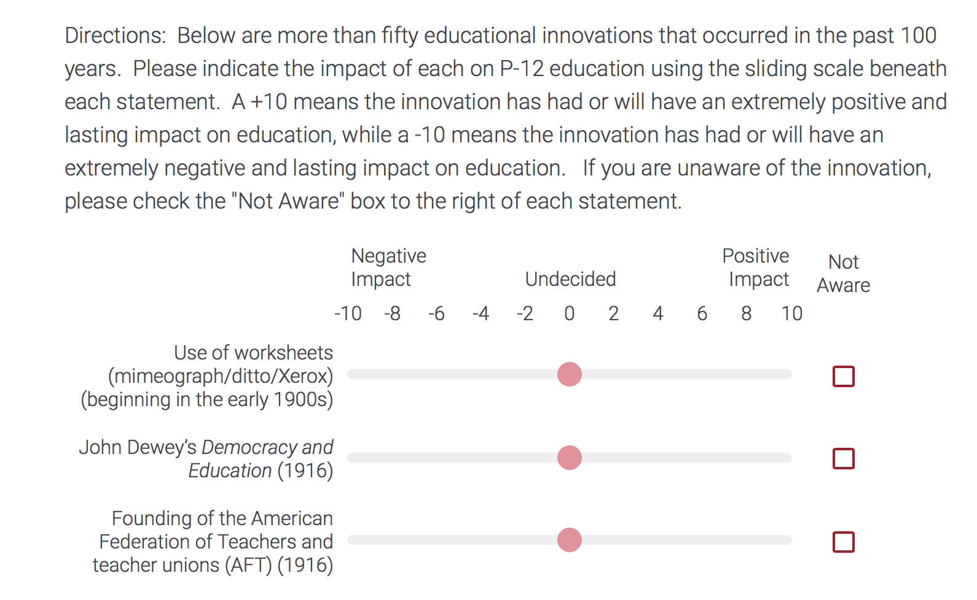
Survey….

Slide 6
Innovations Included in Survey…
Use of worksheets (mimeograph/ditto/Xerox) (beginning in the early 1900s)
John Dewey’s Democracy and Education (1916)
Founding of the American Federation of Teachers and teacher unions (AFT) (1916)
Ability grouping/tracking/heterogeneous/homogenous (beginning in the early 1900s)
Gifted Education movement (beginning early 1900s)
Jean Piaget’s The Child’s Conception of the World (1929)
Opaque projector (beginning in the early 20th century)
Basal reader (Scott Foresman, Houghton Mifflin, Pearson, etc.) (1930-present)
“Wechsler Intelligence Scale for Children” (1939)

Slide 7
G.I. Bill of Rights (1944)
National School Lunch Act—free and reduced lunch (now includes breakfast) (1945)
The Scholastic Aptitude Test (SAT) (1926) and the ACT Test (1959)
U.S. Supreme Court ruling Brown vs. Board of Education (1954) and the Civil Rights Act of 1964 and school desegregation
New math movement (beginning in 1950s)
National Defense Education Act (result of Sputnik) increase math and science majors (1958)
Overhead projector (beginning in the 1960s)
Lev Vygotsky “Zone of Proximal Development” (1962)
Samuel Kirk coined the term “learning disabilities” (1963)
Elementary and Secondary Education Act first passed—includes Title I “Improving the Academic Achievement of Disadvantaged” (1965)
Project Head Start (1965)

Slide 8
Jerome Bruner’s Toward a Theory of Instruction (1966)
James S. Coleman’s report “Equality of Educational Opportunity” (1966)
William Glasser’s Reality Therapy and Schools Without Failure (1967)
National Assessment of Educational Progress (NAEP)—“Nation’s Report Card” (1969)
Herbert R. Kohl’s The Open Classroom open concept schools (1969)
Title IX of the Education Amendments of (1972)
Rehabilitation Act Section 504 (1973)
PL 94-142 “Education for All Handicapped Children Act” (1975) and PL 101-476 the Individuals with Disabilities Education Act (IDEA) (1990)
Year round school/balanced calendar school year (beginning in the 1970s)
Introduction of Apple computers into the classroom—Apple IIe (1977)

Slide 9
United States Department of Education created (1980)
Computer Assisted Instruction/Learning/Education (beginning in the 1980s)
Madeline Hunter’s Mastery Teaching and “Essential Elements of Instruction” (1982)
John Goodlad’s A Place Called School (1984)
Outcome-Based Education (OBE) (beginning in the 1980s)
National Commission on Excellence in Education’s report “A Nation at Risk” (1983)
Whole language movement (beginning in the mid 1980s)
“America 2000” and “Goals 2000: Educate American Act” (1994)
Broadband Internet (beginning in the 1990s)
PowerPoint (beginning in the 1990s)

Slide 10
Report of the National Reading Panel “Teaching Children to Read” (2000)
School voucher movement (beginning in the 1990s)
Smart Board is introduced by SMART Technologies (1991)
Charter Schools—Minnesota opens first charter school (1992)
Alternative routes to teacher certification/licensing (beginning in the 1990s)
Charlotte Danielson’s Enhancing Professional Practice: A Framework for Teaching (1996)
Massachusetts Education Reform Act requiring common curriculum and statewide tests (1993)
The Higher Education Act amended requiring a report card for teacher preparation (Title II) (1998)

Slide 11
Online/distance education (beginning late 1990s)
Diane Ravitch Left Back: A Century of Failed School Reforms (2000)
STEM education movement (National Academies of Sciences) (2000s)
“No Child Left Behind” ESEA and mandated state testing (2002)
Common Core State Standards (2009)
Teacher pay tied to evaluation and student achievement (2000s)
Handheld computers devices and tablets (2000s)

Slide 12
Results…

Slide 13
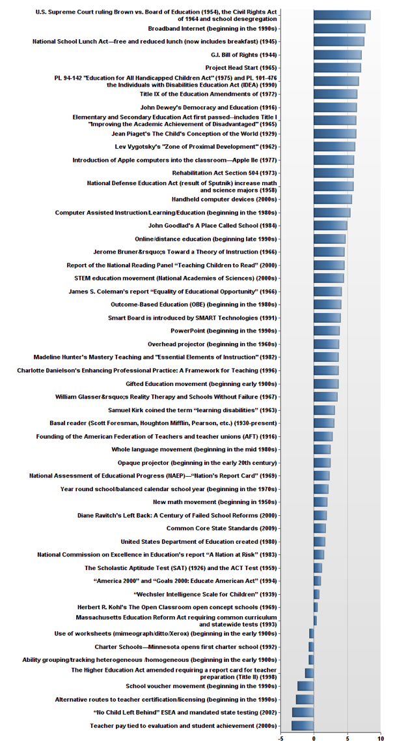
Positive
Negative

Slide 14
Top 5 Positive Impact
#5 Project Head Start (1965)—7.01
#4 G.I. Bill of Rights (1944)—7.11
#3 National School Lunch Act—free and reduced lunch (now includes breakfast) (1945)—7.50
#2 Broadband Internet (beginning in the 1990s)—7.68
#1 U.S. Supreme Court ruling Brown vs. Board of Education (1954) and the Civil Rights Act of 1964 and school desegregation—8.51

Slide 15
Top 5 Negative Impact
#5 The Higher Education Act amended requiring a report card for teacher preparation (Title II) (1998) -1.27
#4 School voucher movement (beginning in the 1990s) -2.44
#3 Alternative routes to teacher certification/licensing (beginning in the 1990s) -2.69
#2 “No Child Left Behind” ESEA and mandated state testing (2002) -3.21
#1 Teacher pay tied to evaluation and student achievement (2000s) -3.32

Slide 16
Analyzing
the
Results

Slide 17
Positive
#5 Project Head Start (1965)
7.01
#4 G.I. Bill of Rights (1944)
7.11
#3 National School Lunch Act—free and reduced lunch (now includes breakfast) (1945)
7.50
#2 Broadband Internet (beginning in the 1990s)
7.68
#1 U.S. Supreme Court ruling Brown vs. Board of Education (1954) and the Civil Rights Act of 1964 and school desegregation
8.51
What are the commonalities among these 5 innovations?
What do these innovations collectively imply?
What can we infer or generalize from them as a group?
What are the overall positive results of these innovations?

Slide 18
Key Points…
The top five positive innovations provided access and opportunity
Gave individuals a fair playing field
Came from a generation that emphasized individual responsibility
No blame implied

Slide 19
Negative
#5 The Higher Education Act amended requiring a report card for teacher preparation (Title II) (1998)
-1.27
#4 School voucher movement (beginning in the 1990s)
-2.44
#3 Alternative routes to teacher certification/licensing (beginning in the 1990s)
-2.69
#2 “No Child Left Behind” ESEA and mandated state testing (2002)
-3.21
#1 Teacher pay tied to evaluation and student achievement (2000s)
-3.32
What are the commonalities among these 5 innovations?
What do these innovations collectively imply?
What can we infer or generalize from them as a group?
What are the overall negative results of these innovations?

Slide 20
Key Points…
All are federal government policies that express certain beliefs
Because of the widening student achievement gap between students of poverty/ethnicity/race and the rest of the nation, the government must intervene
To solve the problem, the federal government has wrested the steering wheel away from educators
Educators have failed and must be held accountable
Legislation can solve the gap in student performance
Solutions come from the top down
The result has been increased testing, the shortening of instructional time, and the gap remains

Slide 21
The Challenge

Slide 22
Based on the two groups’ (top 5 positive/negative), what is implied as the next most needed innovation?
In what meaningful realistic ways can educators better influence legislative policy and practice?
How can CADERI deans and their facultypositively impact future innovations?

Slide 23
Thank You!

