Slide 1
Council of Academic Deans From Research Education Institutions (CADREI) February 28, 2013 Rosen shingle Creek Hotel Orlando, Florida Using Data Dashboards to Report on Our Own Programs: One University Perspective Ohio University-The Gladys W. and David H. Patton College of Education Web Address: www.cehs.ohio.edu

Slide 2
College View
MISSION: We provide transformative experiences that cultivate a passion for learning. We enhance our community through critical discourse to promote innovative scholarly collaboration for positive change.
VISION: We will be a globally recognized, diverse learning community that develops leaders who bring positive change to their professions and the world.

Slide 3
College Values
The Patton College of Education fosters graduates who have been CALLED to Lead:
Change Agents
Lifelong Learners
Committed to Educational Diversity
Leader-educators & practitioners

Slide 5
College Profile

Slide 6
College Profile continued
One in 13 Public Educator Preparation Programs in Ohio
Located in Southeast Ohio- Foothills of the Appalachia
College Diversity- 12.4%

Slide 7
Academic Dashboard

Slide 8
Academic Dashboard continued

Slide 9
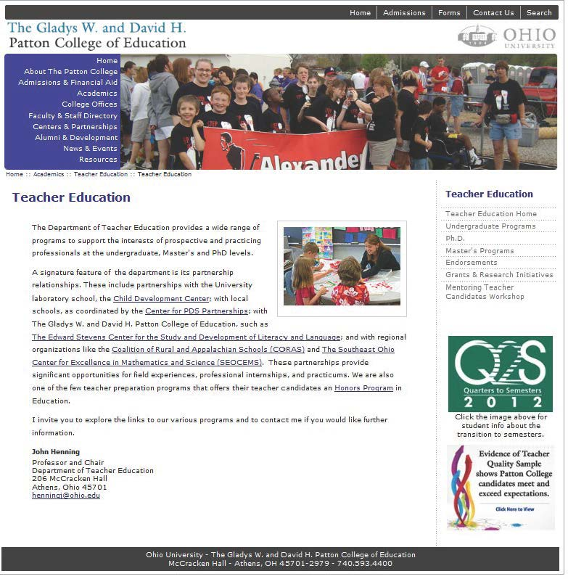
Evidence of Teacher Candidate Quality

Slide 10
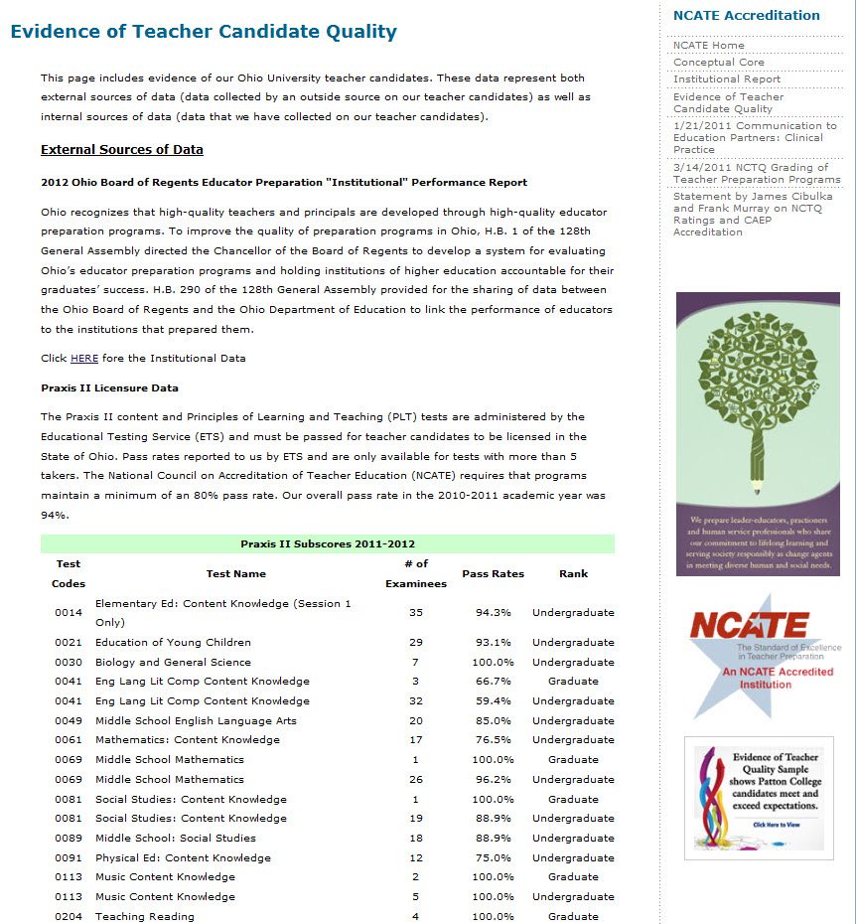
Evidence of Teacher Candidate Quality

Slide 11
External Sources of Data
2012 Ohio Board of Regents Educator Preparation “Institutional” Performance Report www.ohiohighered.org/educator-accountability/performance-report#univ
Praxis II Licensure
Eduventures Survey of OU Patton College of Education Graduates
Eduventures Survey of Patton College Employers
Value-Added Data for Ohio Principals

Slide 12
External Sources of Data continued
In collaboration with representatives from the 13 public and 38 private educator preparation institutions in Ohio, state agencies, and organizations. The Board of Regents worked with the Ohio Department of Education and higher education institutions to collect data on the following identified preparation metrics for the 2011-2012 report:
Licensure Test Scores
Value-added Data (EVAAS)
Candidate Academic Measures
Field/Clinical Experiences
Pre-Service Teacher Candidate Survey Results
National Accreditation
Resident Educator Persistence Data
Excellence & Innovation Initiatives

Slide 13
Internal Sources of Data
Academic Dashboard
Average GPA Data
Testimonials & Student Success Stories

Slide 14
Student Testimonials

Slide 15
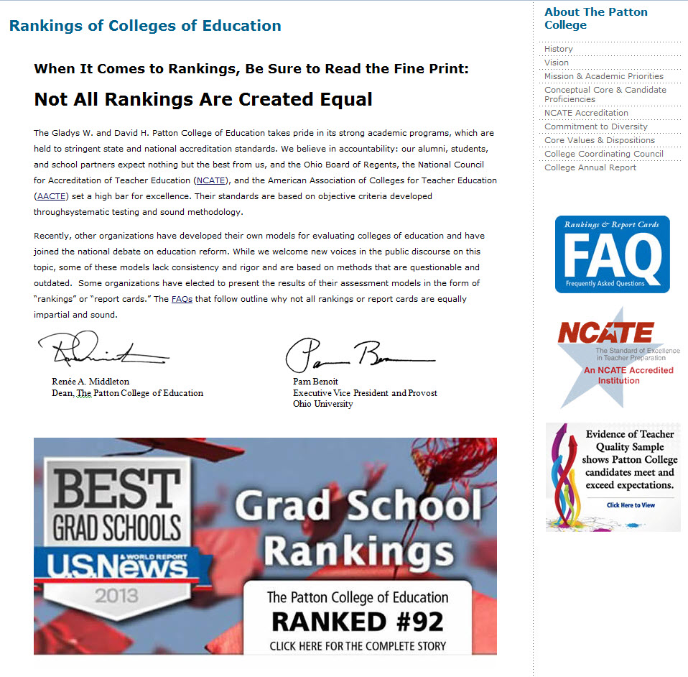
Rankings and Report Card Statement by Provost and Dean

Slide 16
Rankings and Report Card FAQ’s
Why am I getting this message?
What’s the current situation?
What’s happening, and how am I affected?
Why are the current accountability standards better than those used by NCTQ?
What’s the best way to ensure that public education efforts are viewed accurately and fairly?
How can I help?

Slide 17
Thank You!
Renée A. Middleton, Dean
The Patton College of Education
E-mail: middletr@ohio.edu

