Slide 1
Using Gallup Polls to Transform Education
Shane J. Lopez, Ph.D.
Gallup Senior Scientist in Residence
Research Director at The Clifton Strengths School
Presented at the CADREI Annual Fall Meeting on October 18, 2010

Slide 2
What Americans Think and Feel about Life and School
Gallup Student Poll
Gallup Teacher Poll
PDK/Gallup Poll
Copyright © 2010 Gallup, Inc. All rights reserved.
2

Slide 3
Gallup Student Poll

Slide 4
Gallup Student Poll Background
The Gallup Student Poll is a 20-item measure of hope, engagement, and
well-being. Gallup researchers targeted these three variables because they
met the following criteria:
-They can be reliably measured. -They have a meaningful relationship with or impact on educational
outcomes. -They are malleable and can be enhanced through deliberate action.
-They are not associated with FARL status or family household income. -They are not measured directly by another large-scale survey or testing
program.
Hope | ideas and energy we have for the future | Double Hope
Engagement | involvement in/enthusiasm for school | Build Engaged Schools
Well-being | how we think about and experience our lives | Boost Well-Being
Copyright © 2010 Gallup, Inc. All rights reserved.
4

Slide 5
Gallup Student Poll Hope Index
Hopeful – 53%
Stuck – 31%
Discouraged – 16%
Copyright © 2010 Gallup, Inc. All rights reserved.
5

Slide 6
Gallup Student Poll Hope Items – Representative Sample
9 out of 10 children in America strongly believe that they will graduate from high school. 9.5 out of 10 children in America strongly agree that there is an adult in their life who cares about his or her future. 6 out of 10 children in America strongly believe that they can think of many ways to get good grades. 4 out of 10 children in America strongly agree that they energetically pursue their goals. 4 out of 10 children in America strongly believe that they can find lots of ways around any problem. 5 out of 10 children in America are hopeful that they will find a good job when they graduate.
Copyright © 2010 Gallup, Inc. All rights reserved.
6

Slide 7
Gallup Student Poll Engagement Index
Engaged – 63%
Not Engaged – 23%
Actively Disengaged – 14%
Copyright © 2010 Gallup, Inc. All rights reserved.
7

Slide 8
Gallup Student Poll Engagement Items – Representative Sample
7 out of 10 children in America report they have a best friend at school. 6 out of 10 children in America say they feel very safe at school. 5 out of 10 children in America say teachers make schoolwork seem important. 4 out of 10 children in America strongly agree that they get to do what they do best everyday at school. 4 out of 10 children in America got praise and recognition in the last seven days.
Copyright © 2010 Gallup, Inc. All rights reserved.
8

Slide 9
Gallup Conceptualization of Youth Wellbeing
Wellbeing
Objective
Subjective
Achievement
Graduation
Health
FARL/HHI/PI
Evaluative
Experienced
What one experiences in life, daily
How one rates their life
Copyright © 2010 Gallup, Inc. All rights reserved.
9

Slide 10
Gallup Student Poll Well-Being Index
Thriving – 70%
Struggling – 29%
Suffering – 1%
Copyright © 2010 Gallup, Inc. All rights reserved.
10

Slide 11
Gallup Student Poll Experienced Wellbeing Items – Representative Sample
8 out of 10 children in America report that they were treated with respect all day yesterday.
9 out of 10 children in America smiled or laughed a lot yesterday. 8 out of 10 children in America learned or did something interesting yesterday. 9 out of 10 children in America had the energy to get things done yesterday.
Copyright © 2010 Gallup, Inc. All rights reserved.
11

Slide 12
Ready for the Future Index and Implications
34% American Students are Ready for the Future.
Accrue 20% more credits in freshmen year
Earn a GPA one letter grade higher
Have fewer health concerns
Get more rest
Copyright © 2010 Gallup, Inc. All rights reserved.
12

Slide 13
PDK/Gallup and Gallup Student Poll Crosswalk
Top Box Percent
Copyright © 1993-1998, 2010 Gallup, Inc. All rights reserved.
13

Slide 14
The Community’s Solutions
Students tell stories.
Parents and Other Caregivers start conversations.
Teachers, Counselors, and Advisors do activities.
Principals and Superintendents consider policy implications.
Afterschool Counselors and Peer Mentors modify programs.
Business People and Neighbors engage in small acts.
Copyright © 2010 Gallup, Inc. All rights reserved.
14

Slide 15
Gallup Teacher Poll

Slide 16
Student and Educational Services Engagement

Slide 17
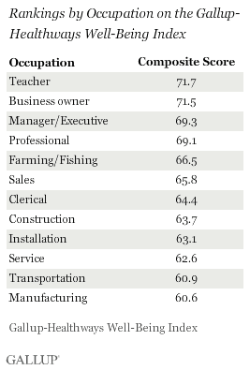
Teachers Rank Highest in Wellbeing
Copyright © 2010 Gallup, Inc. All rights reserved.
17

Slide 18
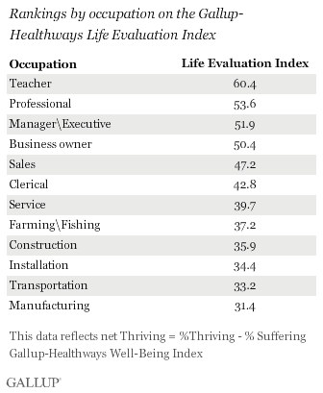
Teachers Rank Highest in Wellbeing
Copyright © 2010 Gallup, Inc. All rights reserved.
18

Slide 19
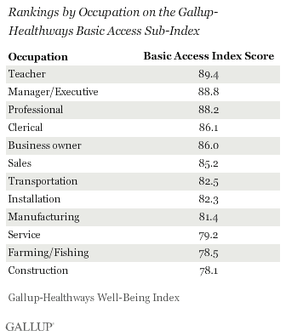
Teachers Rank Highest in Wellbeing
Copyright © 2010 Gallup, Inc. All rights reserved.
19

Slide 20
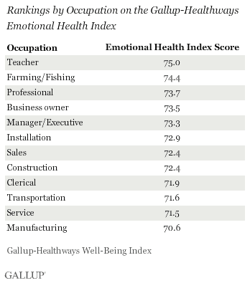
Teachers Rank Highest in Wellbeing
Copyright © 2010 Gallup, Inc. All rights reserved.
20

Slide 21
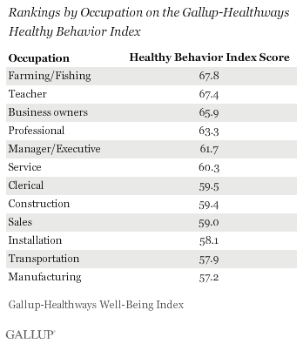
Teachers Rank Highest in Wellbeing
Copyright © 2010 Gallup, Inc. All rights reserved.
21

Slide 22
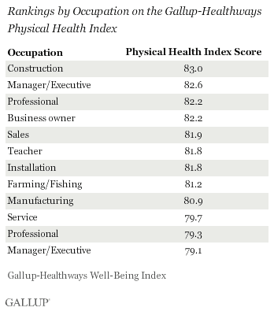
Teachers Rank Highest in Wellbeing
Copyright © 2010 Gallup, Inc. All rights reserved.
22

Slide 23
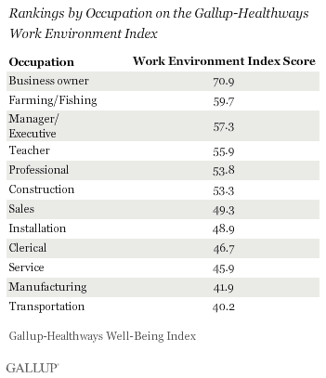
Teachers Rank Highest in Wellbeing…Except on WEI
Copyright © 2010 Gallup, Inc. All rights reserved.
23

Slide 24
PDK/Gallup Poll

Slide 25
Trust and Confidence in Teachers
Copyright © 2010 Gallup, Inc. All rights reserved.
25

Slide 26
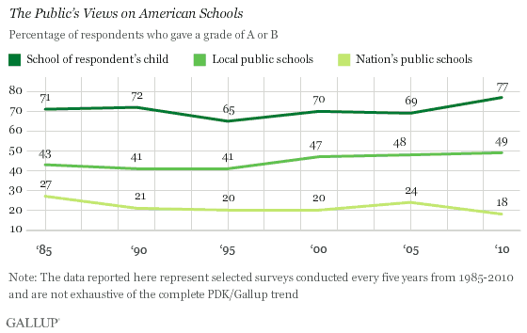
The Public’s Views on American Schools
Copyright © 2010 Gallup, Inc. All rights reserved.
26

Slide 27
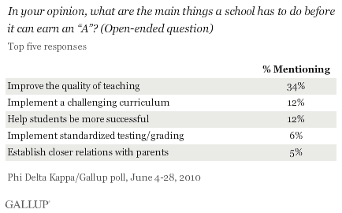
How Schools Can Make an A
Copyright © 2010 Gallup, Inc. All rights reserved.
27

Slide 28
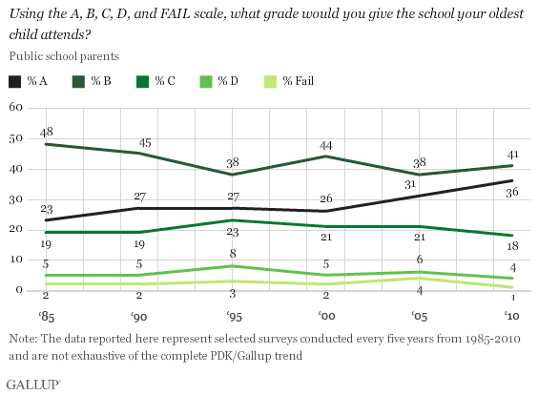
Parents’ Views on Local Schools
Copyright © 2010 Gallup, Inc. All rights reserved.
28

Slide 29
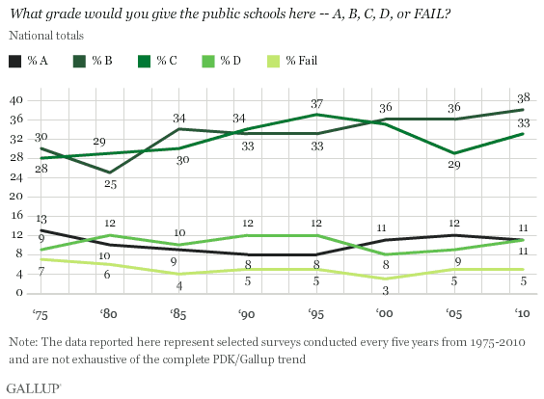
Public’s Views on Local Schools
Copyright © 2010 Gallup, Inc. All rights reserved.
29

Slide 30
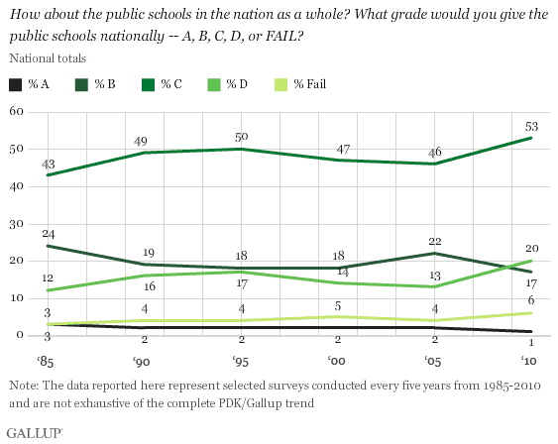
Public’s Views on American Schools
Copyright © 2010 Gallup, Inc. All rights reserved.
30

Slide 31
Recommended Solutions
Hope – Get students and teachers excited about the future
Engagement – Hire great teachers and keep them engaged
Wellbeing – Create wellbeing nudges throughout the community and school
Ready for the Future – Develop strengths-based educational approaches to be used at school and after school
Copyright © 2010 Gallup, Inc. All rights reserved.
31

