Slide 1
The Case for the NEW PPD
Olga Welch, Steve Tozer & David Imig
CADREI Fall Meeting
Charleston, SC
October 20, 2010

Slide 2
The CPED Initiative
Common Commitment to Distinguishing and Differentiating Between the Doctorate in Education (142 Colleges & Universities)
Research Scholars vs. Scholarly Practitioners
Practical and Narrative Knowledge vs. Analytic Knowledge
Guided by a Set of Shared Principles
Work Based on a Shared Language (Shulman)
Capstones and Decathlons and Signature Pedagogies

Slide 3
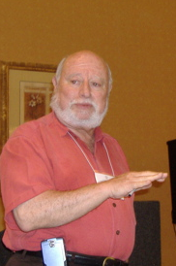
The Professionalization Project
Strengthening Professions by
Strengthening Doctoral
Education
Fostering the
Stewardship of a Profession
Vis a vis
Stewardship of a Discipline
Lee S. Shulman

Slide 4
Making the EdD The Degree of Choice
Directed at Real Problems and Real Solutions
Emphasis is on Preparing Transformational Leaders to Change Schools and Colleges & Other Learning Organizations
Enabling Doctoral Programs to Meet the Needs of Practitioners (Part Time Students with Full Time Responsibilities)
Doing So in a Rigorous, Responsible, Practical, Transparent, and Ethical Manner

Slide 5
Why Do This Work?
Perception: Graduate Education has “Changed Little in 40 Years”
(Measuring Up 2006)
Competition: Domestic Alternative Providers and Foreign Universities and Distance Learning Opportunities (Carey Report)
Need for Standards for Doctoral Programs: (Miller/Spellings &
Higher Ed Commission)
Growing Consensus: A Need for Professional Practice Doctorates
(Psychology, A&S, Pharmacology, Engineering)
Funding Issues: State & Federal Levels
(Declining Public Support/Rising Dependence on Tuition)
Campus Expectations: Emphasis on Research and High Quality (NRC, AERA and NSF/CGS 2020 Project)
Need to Attend to Career Path (CGS, 2010)

Slide 6
The Carnegie Project on the Education Doctorate (Phase I - 2007-2010)
CADREI Sponsored (Carnegie Foundation & Spencer Foundation Supported)
Sought Two Distinct Pathways to the Education Doctorate (Research Doctorate and Professional Practice Doctorate)
Twenty Five Participating Institutions
Multiple Stages of Implementation:
Design Stage
Implementation Stage
Experimentation (Redesign Efforts)

Slide 7
Different Purposes: Different Clients
School Leaders
Leaders for PK-12 Schools
Teacher Educators
Leaders for Schools and Colleges
Organizational Leaders
Learning Organization Leaders

Slide 8
Participating institutions
Arizona State
California State System
Central Florida
Colorado (Denver)
Connecticut
Duquesne (PA)
Florida
Houston
Illinois (Chicago)
Kansas
Kentucky (Lexington)
Louisville
Lynn (FL)
Maryland
Missouri (Columbia)
Nebraska (Lincoln)
Northern Illinois
Oklahoma
Pennsylvania State
Rutgers (NJ)
Southern California
Vanderbilt
Vermont
Virginia Commonwealth
Virginia Tech
Washington State
William & Mary

Slide 9
Phase I Accomplishments
Kept 22 institutions at the table
Fostered a common language (labs of practice, signature pedagogy, scholarship of practice)
Embraced 6 principles for program development
Designed rubrics for assessment
Sponsored an emerging literature on the PPD

Slide 10
A r e a s o f C o n s e n s u s
The PhD and EdD should be different
“Coursework-only” doctorates are unacceptable – professional practice experiences are essential.
The EdD is dependent upon “engaged research” – with questions derived from external entities
There is need for explicit criteria for framing and assessing the EdD
There is the need for the EdD to be as rigorous as the PhD in Education
Standards of excellence must be more than credit hours earned.

Slide 11
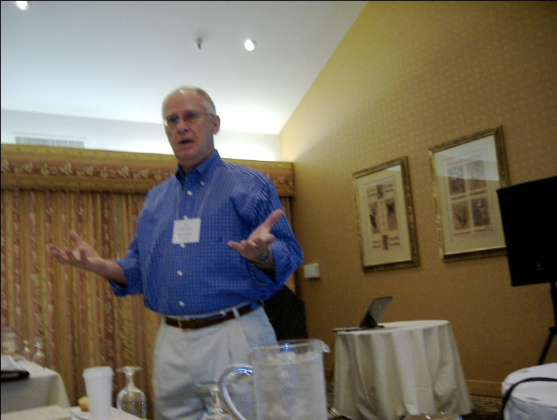
Issues & Concerns
Faculty qualifications & advisement considerations
Admission criteria (GRE scores) & prior work experience considerations
Group (team) products vs. individual candidate contributions
Early decision re: degree of choice
Status perceptions & qualitative concerns
Resource considerations

Slide 12
NEW WAYS OF THINKING
PRACTICAL REASONING
REDEFINITION OF EXPERTISE
USE OF SPACE
MULTIPLE PATHWAYS
ECOLOGICAL CONSIDERATIONS

Slide 13
The Carnegie Project on the Education Doctorate (Phase II: Research & Dissemination)
FIPSE Support for a Three Year Initiative
Focus on Data Gathering—we have:
Data on the institutional change process for SOEs
Ed.D. Program development information
Phase II will allow us to…
Test these data and collect more
Learn from the data and the experiences of our members
Expand and share our findings
Goal is to demonstrate to the education community that the CPED-influenced Professional Practice Doctorate is the means to reclaim the Education Doctorate and make it the choice degree for educational practitioners.

Slide 14
Adding a 2nd Wave
Expanding membership
Pairing with a 1st Wave member
Expanding influence
Focus on rural and minority serving institutions

Slide 15
Data – What Do We Want?
Demographic Data on Applicants & Admitted Students, Graduates & Successful Practitioners
Cohort Data on Knowledge & Skills, Beliefs & Attitudes - Across Program Data
Information on Course Designs, Labs of Practice, Internships, Apprenticeships
Candidate Course Grades, Portfolios, Other Artifacts
Candidate Success on Comps, Proposals & Capstones (Shared Rubrics)
Candidate Success in Appointments, Promotions, Supervisor Evaluations, etc.
Candidate Success on Certifying Examinations

Slide 16
What Do We Need From You
Sustaining the CADREI Commitment
Agreeing to test the outcomes and to measure the impact (data sharing)
Supporting a faculty member to serve as the PI
Funding for GA to support work
Supporting travel to convenings and national meetings
Influence in shaping the agenda

Slide 17
Resources to Guide CPED Work
Shulman, L.S., et.al. (2006) Reclaiming Education’s Doctorates. (ER)
Walker, G.E., et.al. (2008) The Formation of Scholars: Rethinking Doctoral Education for the 21st Century. (CF)
Golde, C.M., et.al. (2005) Envisioning the Future of Doctoral Education: Preparing Stewards of the Discipline. (CF)
Lynch, C. & Hulse, C. (2007) Task Force Report on the Professional Doctorate. (CGS)
Shulman, L.S. (2000) Rethinking the Doctorate. (CF)
Sullivan, W. (2005) Work and Integrity: The Crisis & Promise of Professionalism in America. (CF)

Slide 18
Find out more… www.cpedinitiative.org
THANK YOU!
Jill A. Perry jillaperry@cpedinitiative.org
David Imig davidimig@cpedinitiative.org

